Slide 1
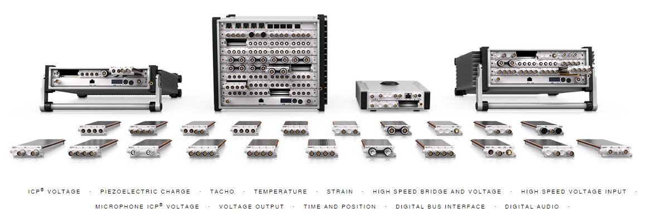
PhoenixKonnect® Application
Transient and Streaming Data Acquisition and Management

Slide 2
PhoenixKonnect® Application
Creates and manages data collection plans
Integrates a wide variety of hardware types
Targets both streaming and transient tests
Retains all settings for test plans
Configures hardware to a Ready state
Previews channels to ensure validity
Acquires, stores and exports in a variety of formats

Slide 3
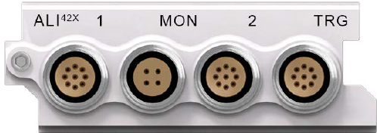
Scenario 1- Transient Application
MECALC ALI42X – 5 Msa/s 24-bit digitizer
Compatible with Spectral Dynamics SDVXI 2805 / 2824 modules
Provides upgrade path for existing SDVXI installations

Slide 4
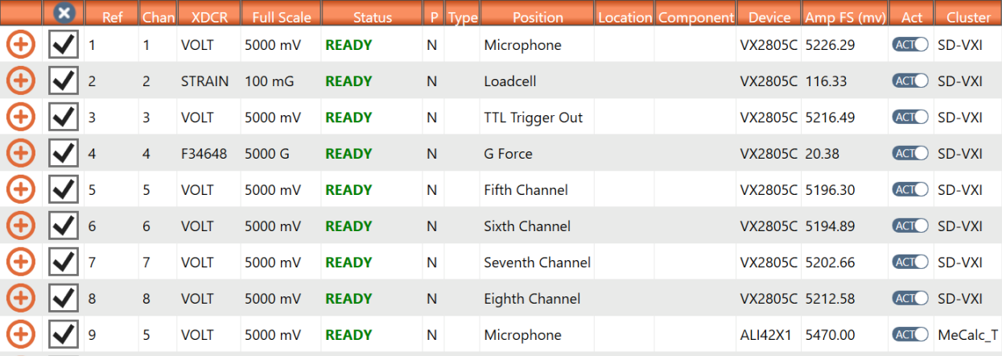
Scenario 1- Transient Application
Test plan – SDVXI + ALI42X

Slide 5
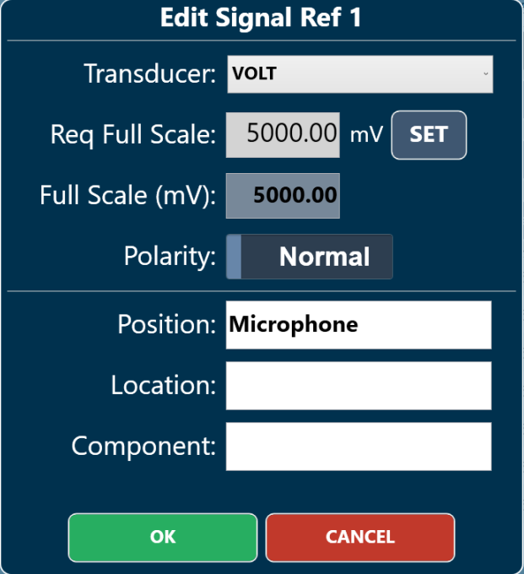
Scenario 1- Transient Application
Signal Configuration Options

Slide 6
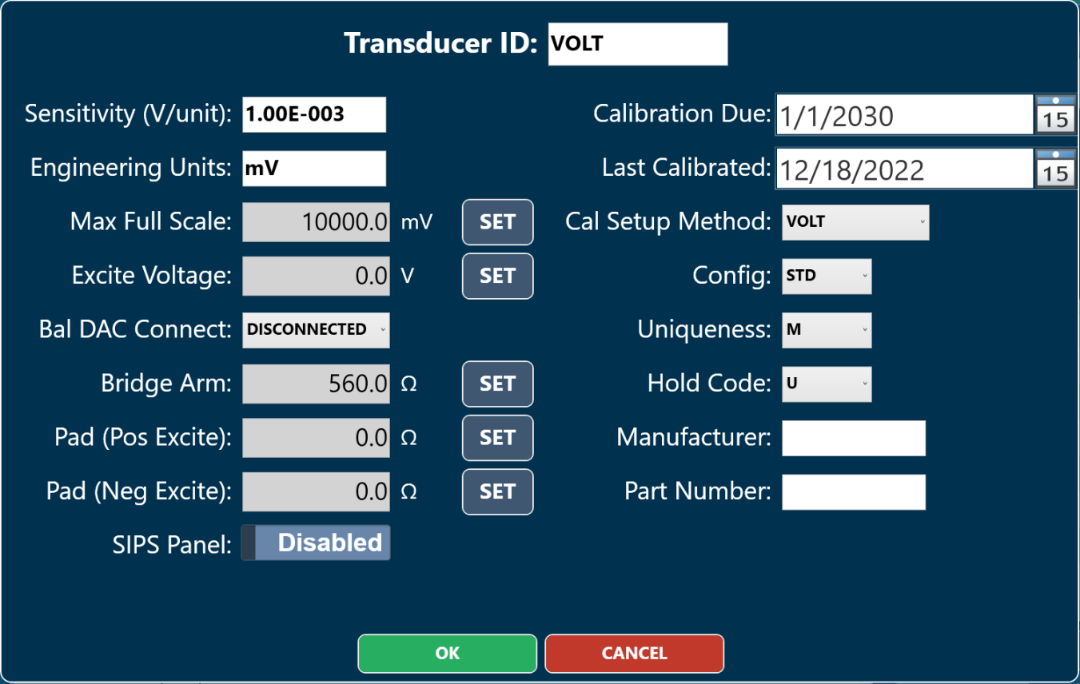
Scenario 1- Transient Application
Transducer Configuration Options

Slide 7
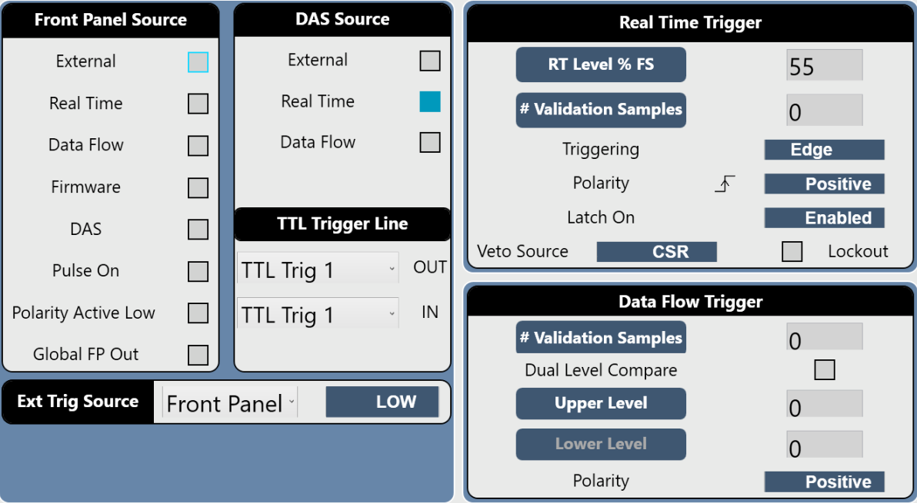
Scenario 1- Transient Application
SDVXI Trigger Options

Slide 8
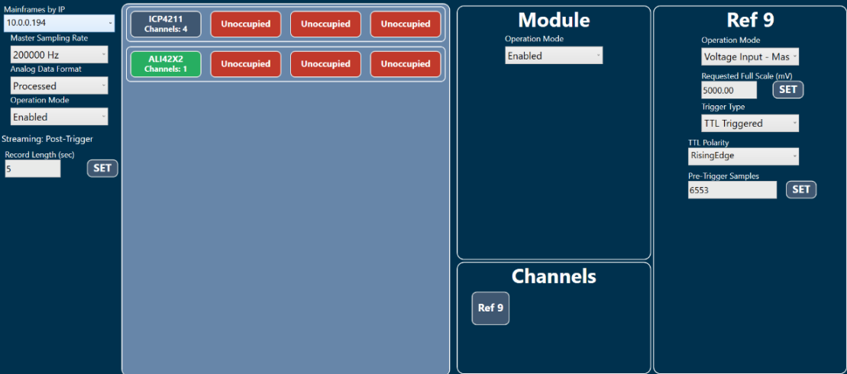
Scenario 1- Transient Application
ALI42X Setup Options

Slide 9
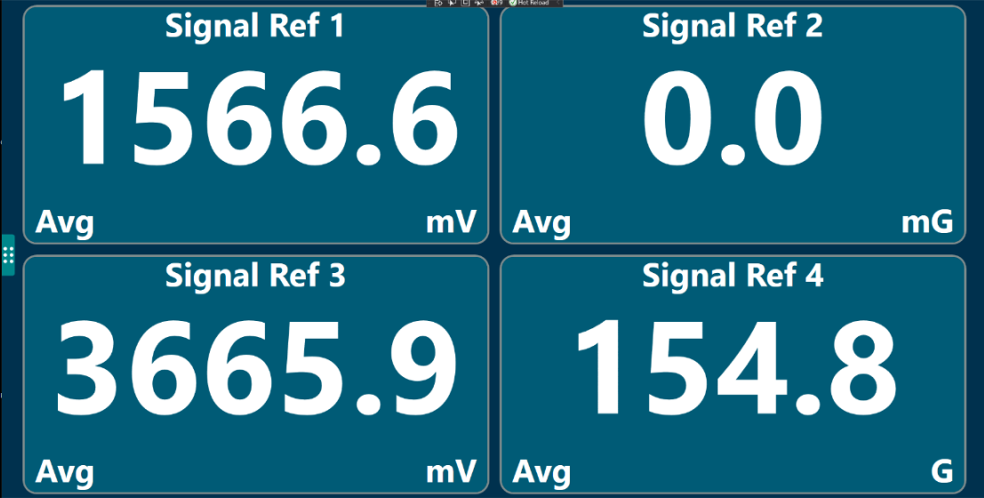
Scenario 1- Transient Application
Real-Time Monitor

Slide 10
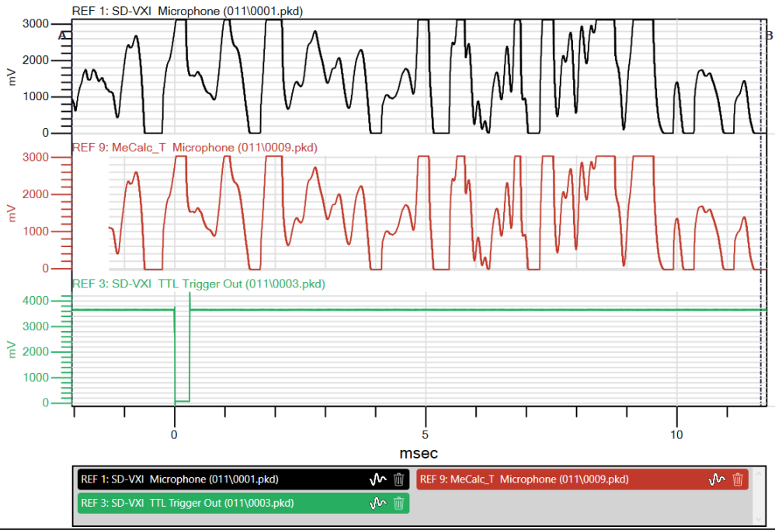
Scenario 1- Transient Application
Data Collection – Doorbell “Gong”

Slide 11
Scenario 2- Streaming Application
Test Plan – ICP4211

Slide 12
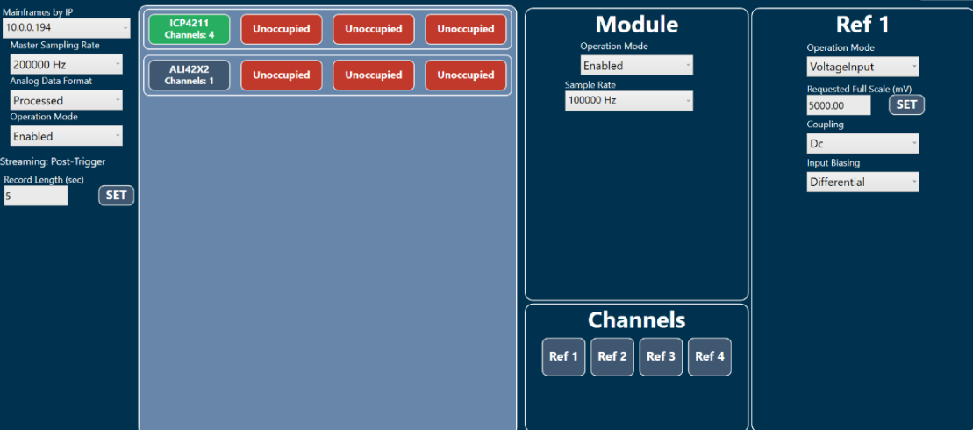
Scenario 2- Streaming Application
ICP4211 Setup Options

Slide 13
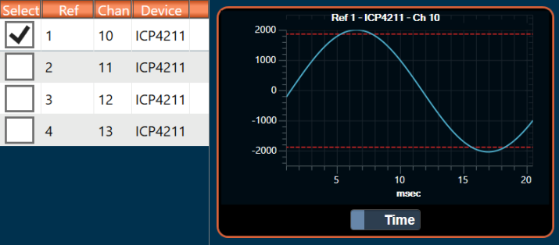
Scenario 2- Streaming Application
Real-Time Monitor

Slide 14
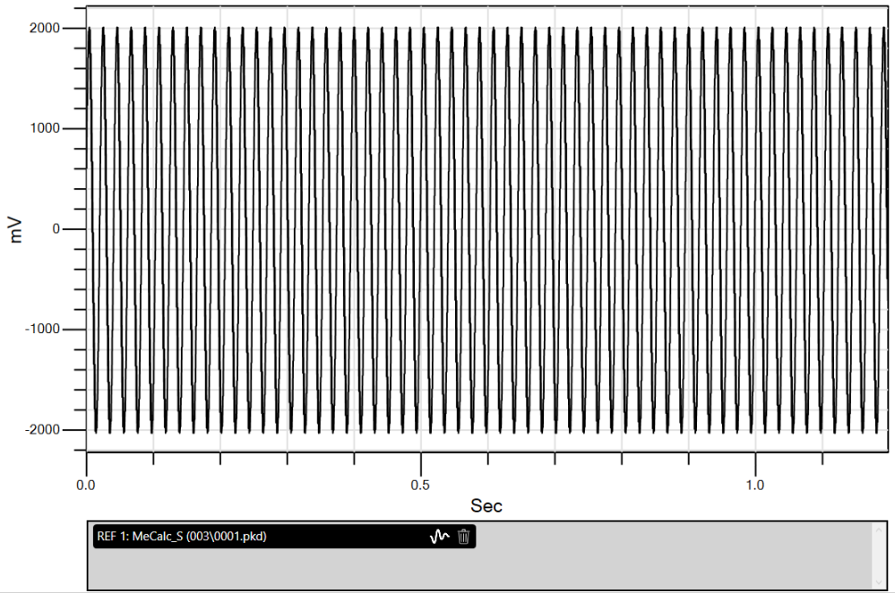
Scenario 2- Streaming Application
Data Collection – Sine Wave

Slide 15
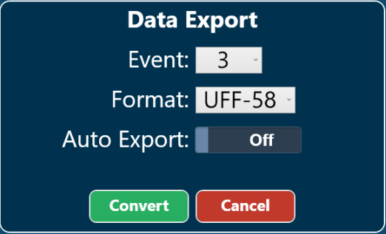
Scenario 2- Streaming Application
Data Export Options

Slide 16
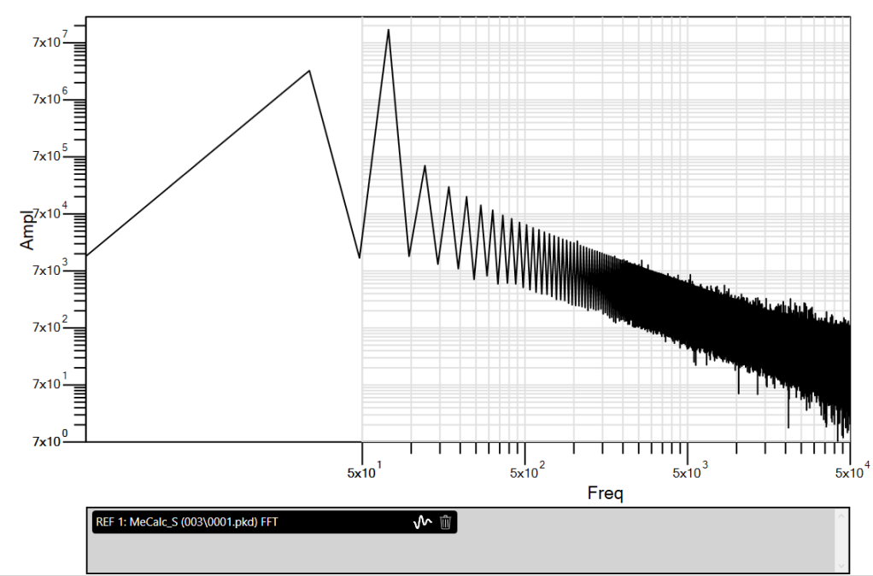
Scenario 2- Streaming Application
Post Processing Options

